Slide 1



























INT104 – Database Management System Unit – III

Slide 2

Guaranteeing Serializability by Two- Phase Locking
Dealing with Deadlock and Starvation

Slide 3

Two-phase locking protocol
A transaction is said to follow the two-phase locking protocol
If all locking operations (read_lock, write_lock) precede the first unlock operation in the transaction.
Such a transaction can be divided into two phases:
an expanding or growing (first) phase
a shrinking (second) phase

Slide 4
Two-phase locking protocol
Expanding or growing (first) phase
during which new locks on items can be acquired but none can be released
Shrinking (second) phase
during which existing locks can be released but no new locks can be acquired.
If lock conversion is allowed,
Upgrading of locks (from read-locked to write-locked) must be done during the expanding phase
Downgrading of locks (from write-locked to read-locked) must be done in the shrinking phase.

Slide 5
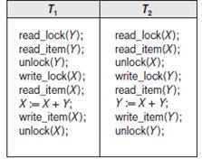
Transactions that do not obey two- phase locking.

Slide 6
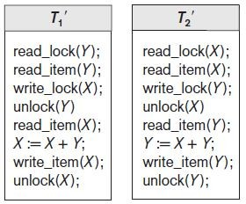
Transactions T1′ and T2′
follow the two-phase locking protocol

Slide 7
2PL Variations
Basic 2PL
Technique described on previous slides
Conservative (static) 2PL
Requires a transaction to lock all accesses before the transaction begins
Predeclare read-set and write-set
Deadlock-free protocol
the items it
It is difficult to use in practice
Because of the need to predeclare the read-set and writeset, which is not possible in some situations.

Slide 8
2PL Variations
Strict 2PL
Transaction does not release exclusive locks until after it commits or aborts
Rigorous 2PL
Transaction does not release any locks until after it commits or aborts

Slide 9
2PL Variations
Notice the difference between strict and rigorous 2PL:
The former holds write-locks until it commits, whereas the latter holds all locks (read and write).
The former must lock all its items before it starts, so once the transaction starts it is in its shrinking phase;
The latter does not unlock any of its items until after it terminates (by committing or aborting), so the transaction is in its expanding phase until it ends.

Slide 10
2PL Variations
Concurrency control subsystem responsible for generating read_lock and write_lockrequests
Locking is generally considered to have a high overhead
because every read or write operation is preceded by a system locking request.
The use of locks can also cause two additional problems: deadlock and starvation

Slide 11
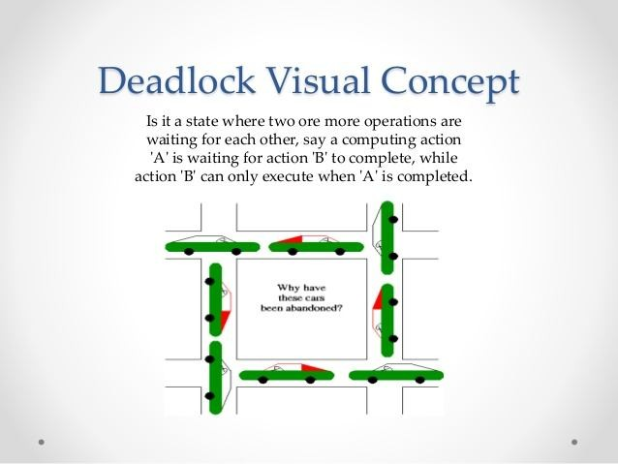
Deadlock and Starvation

Slide 12
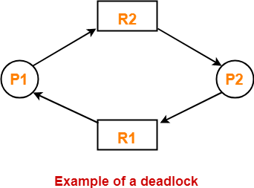
Deadlock
Deadlock occurs when each transaction T in a set of two or more transactions is waiting for some item that is locked by some other transaction T′ in the set.
Hence,
Each transaction in the set is in a waiting queue
Waiting for one of the other transactions in the set to release the lock on an item.
But because the other transaction is also waiting
It will never release the lock.
12

Slide 13
Deadlock Example
Deadlock
T1
read_lock (Y); read_item (Y);
Transactions - T1 and T2 Data Item – x and y
T2
T1 and T2 did follow two-phase policy but they are deadlock
read_lock (X); read_item (x);
write_lock (X); (waits for X)
write_lock (Y); (waits for Y)
Deadlock (T1 and T2)

Slide 14
Dealing with Deadlock and Starvation
Deadlock prevention protocols
Every transaction locks all items it needs in advance
Ordering all items in the database
Transaction that needs several items will lock them in that order
Both approaches impractical

Slide 15
Dealing with Deadlock and Starvation
Protocols based on a timestamp
Timestamp is a unique identifier transaction.
assigned to each
The timestamps are typically based on the order in which transactions are started;
Hence, if transaction T1 starts before transaction T2, then TS(T1) < TS(T2).
Notice that the older transaction (which starts first) has the smaller timestamp value.
Wait-die
Wound-wait

Slide 16
Dealing with Deadlock and Starvation
Protocols based on atimestamp
Wait-die
If TS(Ti) < TS(Tj), then (Ti older than Tj) Ti is allowed to wait;
otherwise (Ti younger than Tj) abort Ti (Ti dies) and restart it later with the same timestamp.
Wound-wait
If TS(Ti) < TS(Tj), then (Ti older than Tj) abort Tj (Ti wounds Tj) and restart it later with the same timestamp;
otherwise (Ti younger than Tj) Ti is allowed to wait.

Slide 17
Dealing with Deadlock and Starvation
No waiting algorithm
If transaction unable to obtain a lock, immediately aborted and restarted later
Cautious waiting algorithm
If Tj is not blocked (not waiting for some other locked item), then Ti is blocked and allowed to wait; otherwise abort Ti.
Deadlock-free

Slide 18

Guaranteeing Serializability by Two- Phase Locking
2PL Variations
Dealing with Deadlock and Starvation
Deadlock Prevention

Slide 19


